Slide 1
Key Stage 4

Slide 2
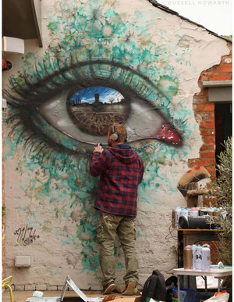
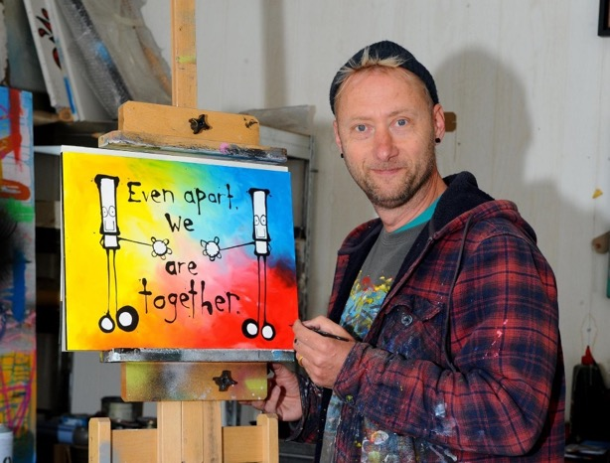
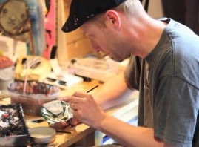
Portsmouth-based street artist, My Dog Sighs.
What is street art?
Practising artist for 20 years.
Internationally known, holding exhibitions around the world including USA, Israel and Australia.
Notes:
We’re going to be finding out about a street artist based in Portsmouth called My Dog Sighs.
What is a street artist or street art? (It is art that is created in a public space, often on walls.)
My Dog Sighs has been a full-time artist for 20 years. He is well known internationally, holding exhibitions and displaying art in countries including USA, Israel and Australia.
However it wasn’t always like that…He was originally a teacher but his dream was always to be an artist. To start with he thought that to become a full-time artist he would need to paint the kinds of pictures you see in art galleries. However art galleries weren’t interested in the paintings that he took to them. My Dog Sighs realised that he wasn’t actually creating art that interested him; he had been painting what he thought would make him an artist.
In 2002 My Dog Sighs came across some street art on a wall in London and this made him realise that to him, art was about stumbling across something unexpectedly that made you stop and think, and this really changed what he wanted to do with his art. However by now he was a family man and didn’t want to start damaging people’s walls or risk getting arrested!

Slide 3
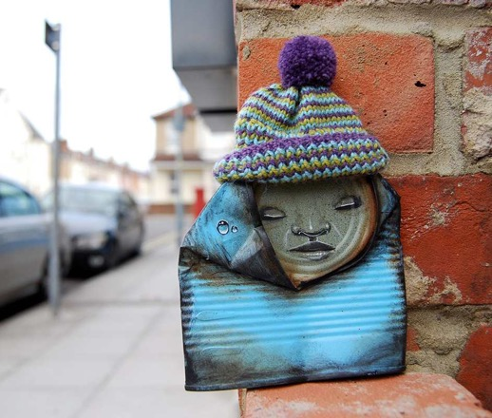
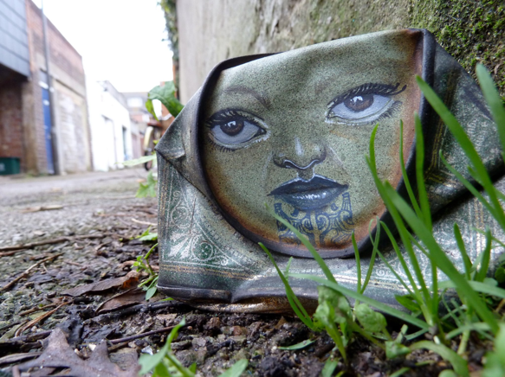
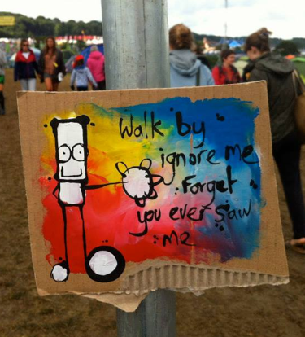
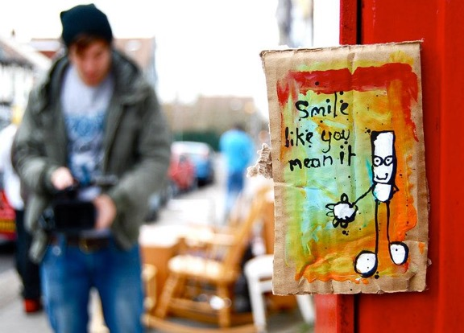
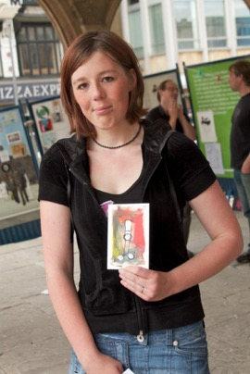
Free Art Friday
What do you think Free Art Friday is?
What do you like / not like about the idea of Free Art Friday?
Notes:
So he carried on being a teacher and just doing art as a hobby, creating the kinds of things that interested him rather than what he thought others wanted.
However, everything changed about 10 years ago because of a project that My Dog Sighs started called Free Art Friday.
Looking at the pictures, can you guess what Free Art Friday is?
He started leaving a piece of his art somewhere in Portsmouth every Friday. He would leave a little tag on it saying ‘Free art. I’m yours. Take me home.’ Here you can see the types of art he would leave and photos of people who found some of his art.
He started to post pictures online of what he was leaving out and soon other artists started to follow suit. Free Art Friday began to grow online, with artists taking the idea and adjusting it to suit themselves and their environment. Free Art Friday now happens all round the world with people leaving pieces of their art for others to pick up. What do you like of not like about the concept of Free Art Friday?

Slide 4
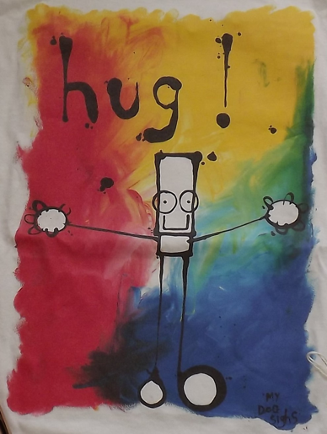
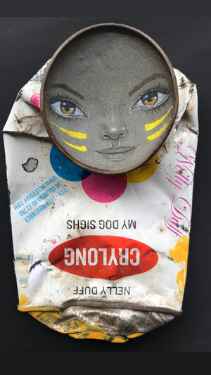
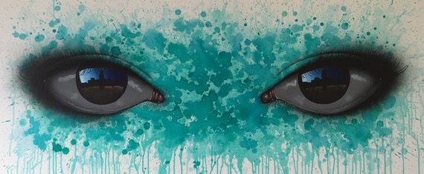
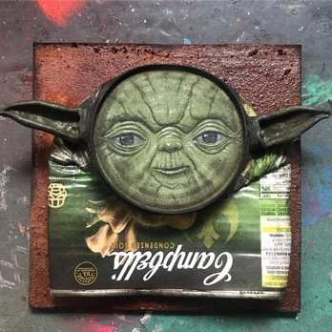
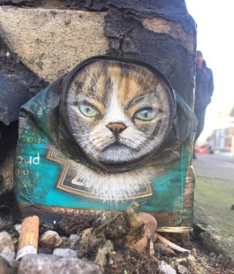
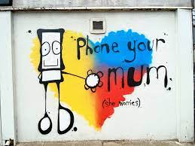
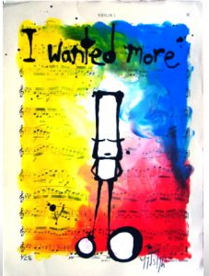
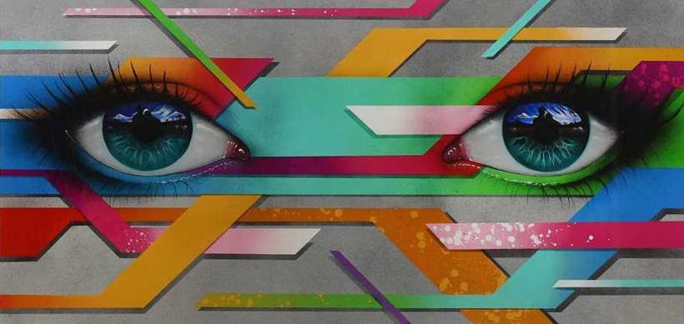
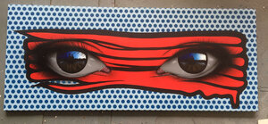
3 themes
Notes:
From getting well-known for Free Art Friday, it went crazy from there. He quickly went part time in his teaching job then gave in his notice and started painting full time. HIs feet haven’t hit the ground since. My Dog Sighs is best known for 3 particular styles.
Look closely at this slide; can you spot 3 themes?
The black and white character on the colourful background he calls Everyman. He often includes words from songs with it.
He creates characters with life-like faces out of found objects, for example crushed tins.
He’s well-known for his hyper-realistic eyes. (Hyper-realistic means that they look real but in an unusual or striking way.) What do you notice when you look closely at these eyes? (In the shiny surface of the eyeball he has painted a reflection of an image – it may be people, places or stories.)

Slide 5
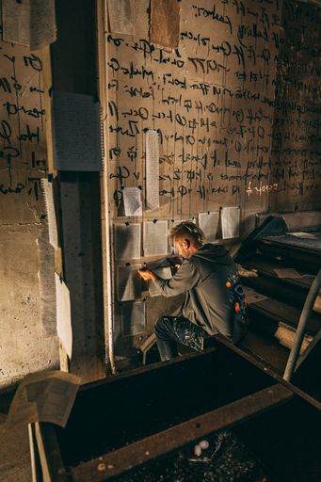
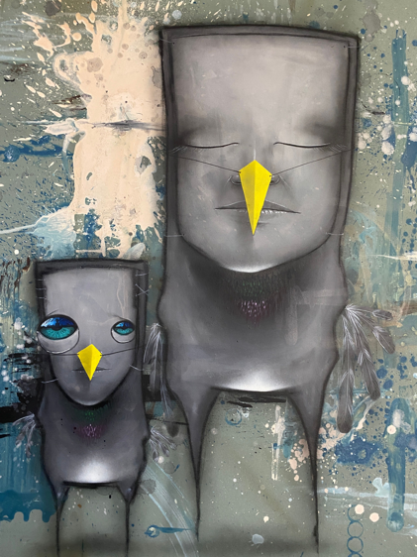
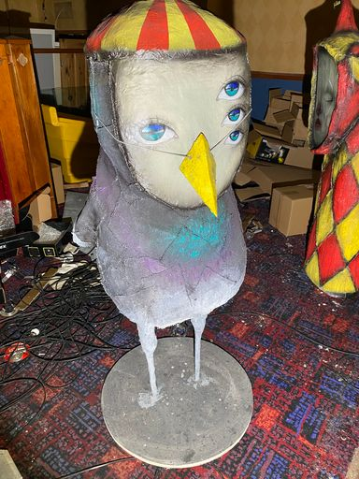
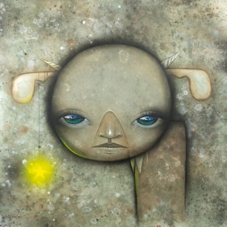
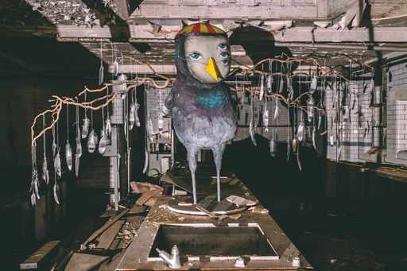
‘Inside’
What do you think
‘Inside’ is?
Notes:
Much of My Dog Sighs’ work until now has been outdoors – as a street artist a lot of it is on walls and sides of buildings. But he has been working on a new and exciting art project (in Portsmouth), the biggest he's ever done. This is very different from his usual work as he includes sculpture. It will be open to the public in the middle of July. This art project is called 'Inside'.
Can you guess what this project is about? (There is a clue in the name!)
This art project is in fact the whole inside of a building. A building which has stood empty for over 20 years. What do you think it will look like/smell like/feel like inside this derelict building?
This is a change for My Dog Sighs as he is used to working outside where his art can be viewed by everyone. He has taken over a derelict building and made the whole thing into a work of art. This is known as an art installation, a term for a type of 3-dimensional art that takes over a whole space.
If time, watch 3 minute video of My Dog Sighs at work on his art project Inside with some images of the building. https://vimeo.com/566575238 password mds As a focus ask them to make a note of 5 different methods that he uses to create the work. (painting (wooden hands),spraying (on walls), fingerpainting, delicate painting eyes on walls with a thin brush, sculpture (one of his Quiet Little Voices with raincloud).

Slide 6
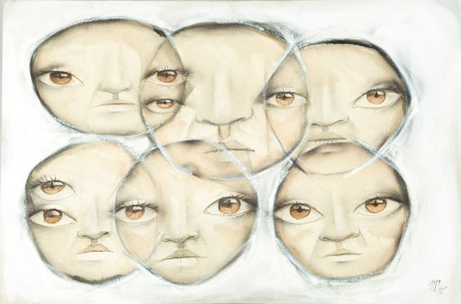
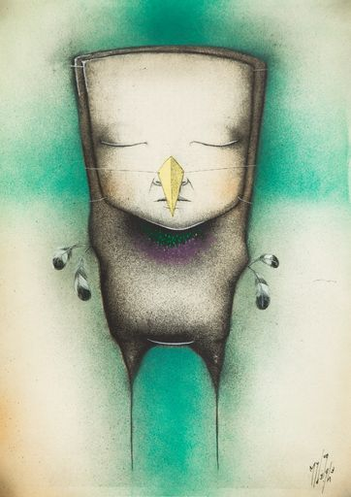
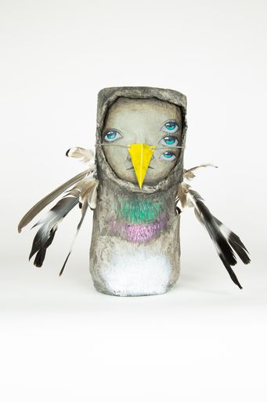
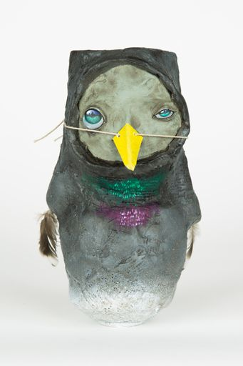
Quiet Little Voices
What is an
anthropomorphic creature?
Notes:
This art project tells a story of a world inhabited by My Dog Sigh’s own anthropomorphic creatures, which he's called his ‘Quiet Little Voices’. What is an anthropomorphic creature? (Anthropomorphic means having human characteristics.)
You'll find these strange creatures in every nook and cranny of the building, finding shelter, creating their own language and making artwork. You'll see them as paintings on walls, or painted tin cans hidden away, or sculptures made out of all sorts of things. All of them have been created by My Dog Sighs.
Each creature in the building represents a different aspect of the human experience, for example some are joyful, playful and mischievous, whereas others are lost, mournful, confused, fearful or scared.
What do you find interesting/unique/different about these creatures?
Do you notice something in particular that features on 3 of the 4 pictures on this slide? (They have beaks tied on with string and some have feathers.)
What do you think that symbolises? (They want to fly so they’re trying to be birds!)

Slide 7
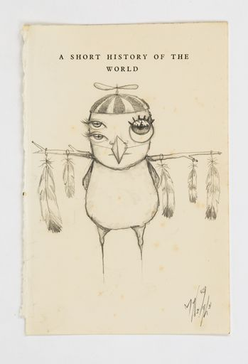
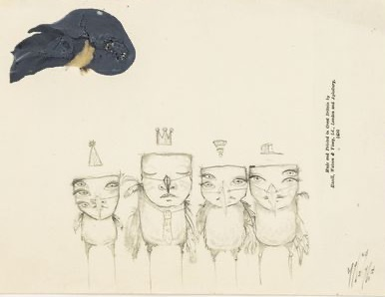
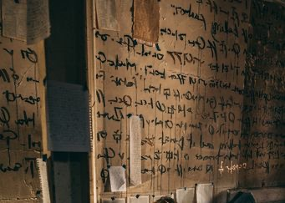
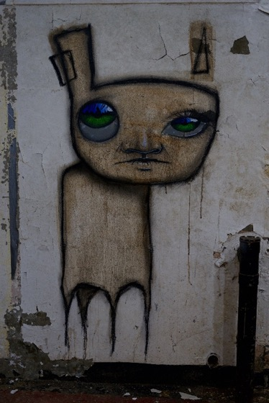
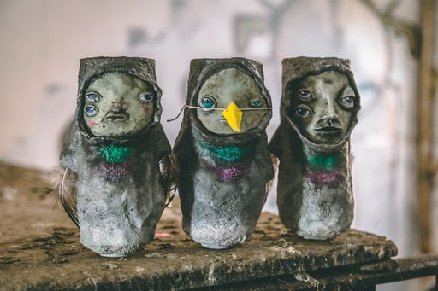
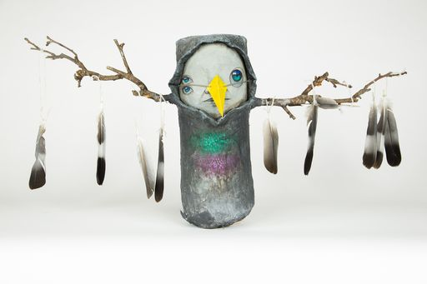
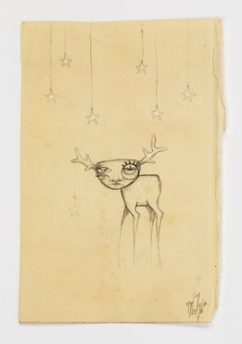
Notes:
These creatures have taken over the derelict space and have even created their own language, which they have scribbled all over the walls. What can you say about the faces of these creatures? How do they make you feel?
The creatures started life as scribbled doodles in the margins of My Dog Sighs’ sketchbooks and were inspired by the artist’s own life experiences and emotions. Each of these creatures represents a different facet of My Dog Sighs’ journey.
Some of the creatures are 2D, some are 3D.

Slide 8
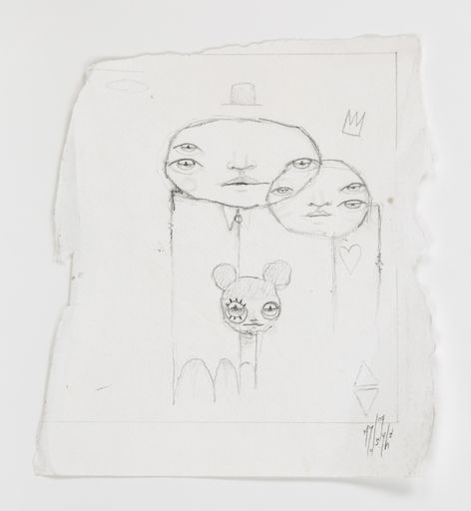
Think of your ‘quiet little voices’.
fearful
anxious
joyful
excited
mischievous
energetic
angry
adventurous
lonely
annoyed
calm
happy
peaceful
hopeful
fun
Notes:
My Dog Sighs talks about his ‘Quiet Little Voices’ doing the art that he produces, rather than him.
Discuss the concept of ‘quiet little voices’.
What are your quiet little voices that describe aspects of your personality that form part of who you are and what you do?
Write down as many different words that spring to mind when you think about yourself.
If they’re struggling click to reveal other words they can use.

Slide 9
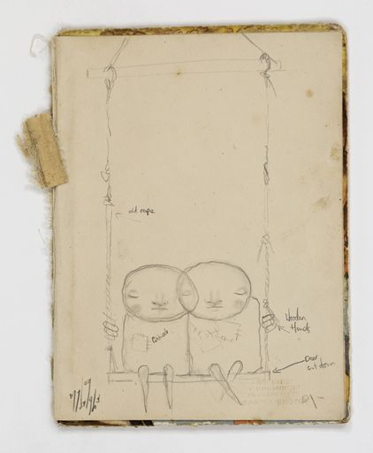
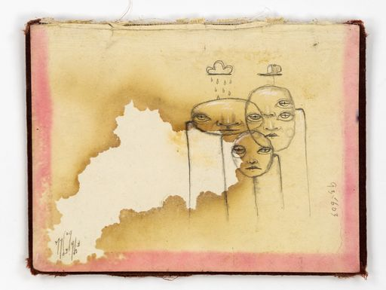
Activity 1: Create your ‘quiet little voices’ creatures inspired by My Dog Sighs
How will they portray the emotions and characteristics you chose?
Notes:
The task today is to draw sketches of your own ‘Quiet Little Voices’ creatures.
Use your imagination and think about what you want your creatures to look like.
How will they portray the emotions and characteristics that you chose?
What facial expressions will they have?
Will the characters be doing something or just standing? Will they be on their own or in groups?
Will they be based on an animal or purely imaginative?
You can do them in the style of My Dog Sighs or you can make up your own style.

Slide 10
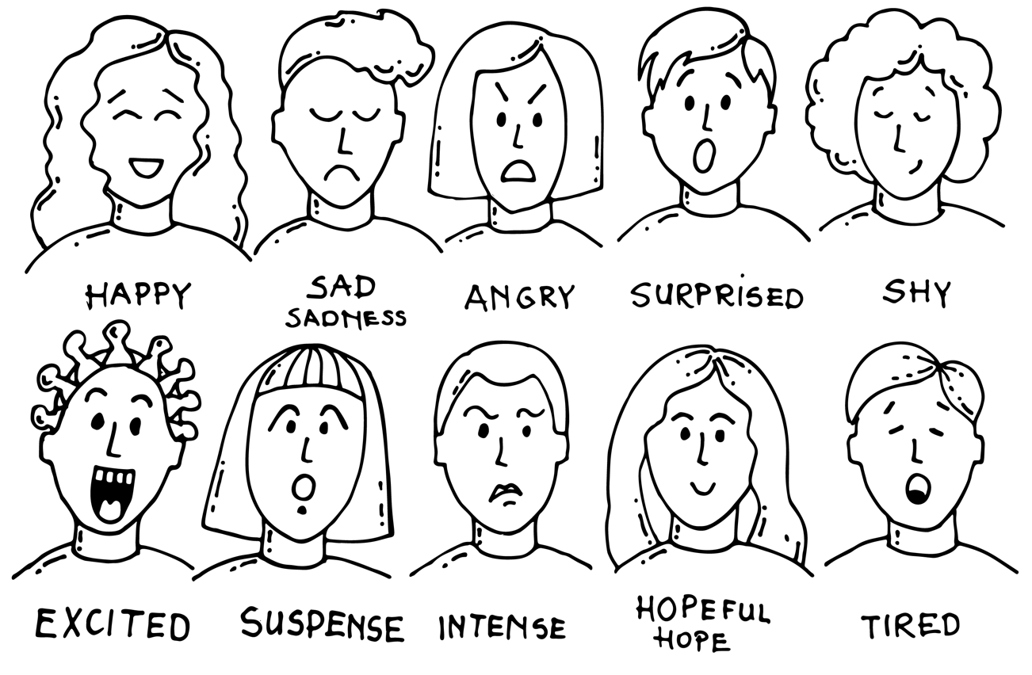
Facial expressions
Notes:
Here are a variety of facial expressions. Have a go at sketching a couple that match some of the words you chose.

Slide 11
Draw your 'quiet little voices’. You may overlap them like this or have them standing alone.
Notes:
They can draw their quiet little voices, either just the faces or the whole creatures. They might like to have them overlapping as My Dog Sighs does sometimes, or as stand alone pictures.

Slide 12
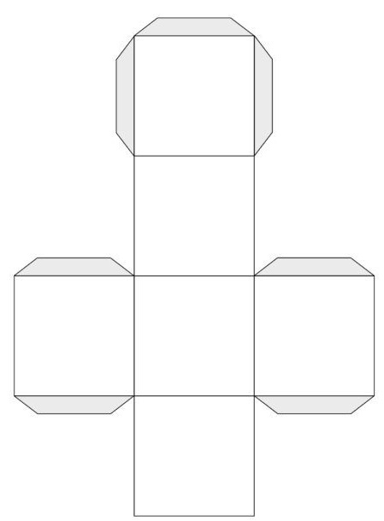
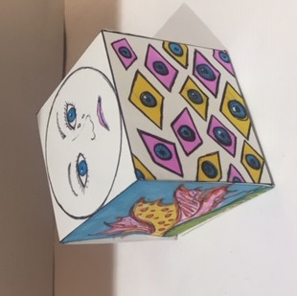
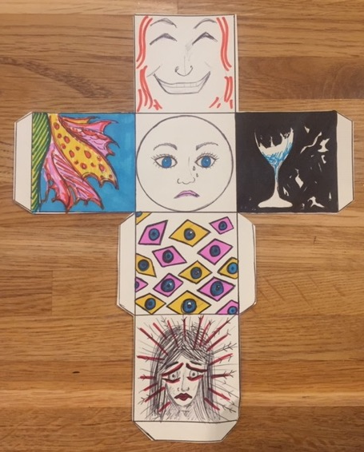
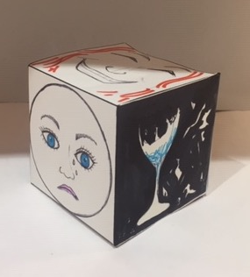
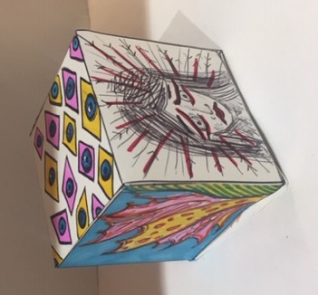
Activity 2: Create an artistic cube made up of your ‘quiet little voices’
How can you symbolise your quiet little voices? Portrait drawings of facial expressions, an object, an abstract pattern, words, textures…
Notes:
The task today is to decorate 6 faces of a cube, each one represent one of your quiet little voices, so the whole cube represents the facets that make up you.
Use Worksheet A.
How could you draw or decorate those quiet little voices? (Using facial expressions, or as patterns, that create a feeling, objects, textures using different materials, words?) Optional – show next slide to try some different facial expressions.
Using the template of the cube, create visuals for each face.
These could be portraits, symbols, patterns, words, textures… the decision is yours!
Just think about creating visuals that evoke a feeling…
(Once they are all complete you could create an art installation by putting all the cubes together – some stacked, some hanging, some stapled to the wall.)

Slide 13
Take away activity
Notes:
Either as an activity if they finish early or to do at home – do some more research on My Dog Sighs. There is an inspiring 15 minute Ted talk, and another talk on YouTube about Inside. Give out 2-sided take away worksheet to take home with further details of My Dog Sighs and Inside.

